Slide 1

Git Version Control
A Powerful Tool for Collaborative Software Development

Slide 2
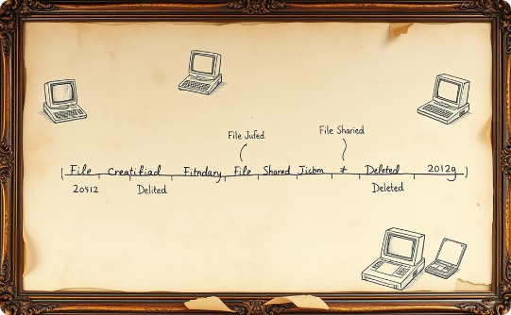


What is Version Control?
Records Changes
Enables Collaboration
Reverts Easily
Tracks file modifications over time.
Allows multiple users to work together efficiently.
Facilitates returning to previous file versions.

Slide 3




What is Git?
Distributed
Created By
Key Features
Tracks changes in source code.
Linus Torvalds in 2005.
Branching, merging, speed.

Slide 4
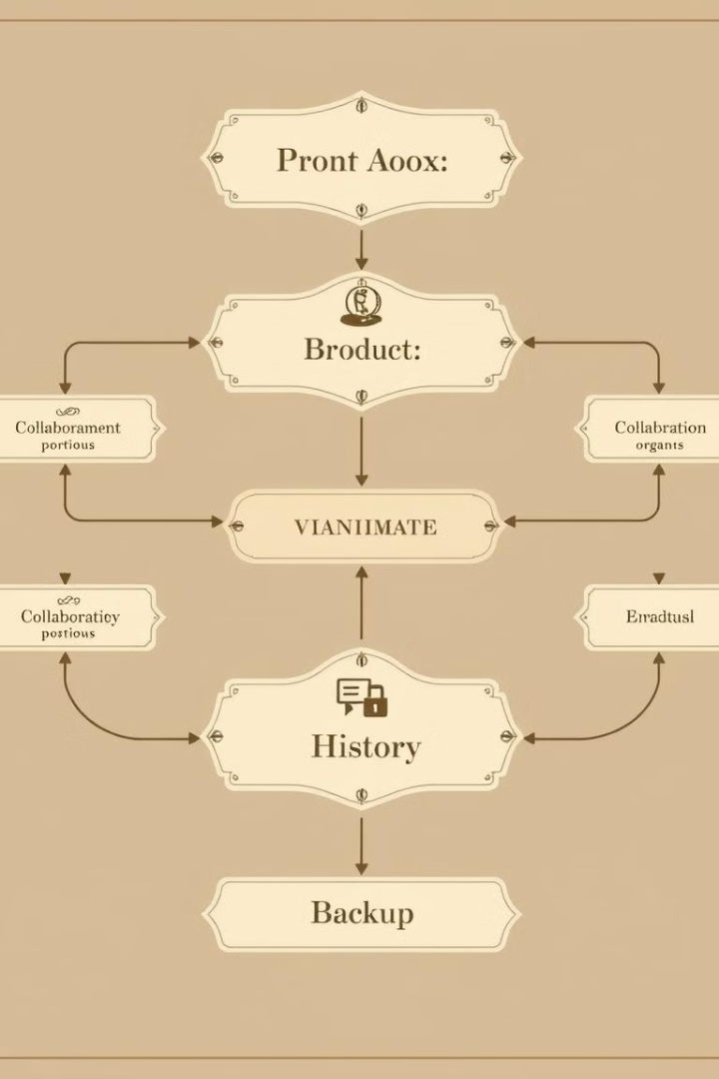
Benefits of Using Git
1
Collaboration
Multiple developers work together.
2
Branching
Experimentation and feature development.
3
Version History
Complete history of changes.
4
Backup
Acts as a code backup.

Slide 5
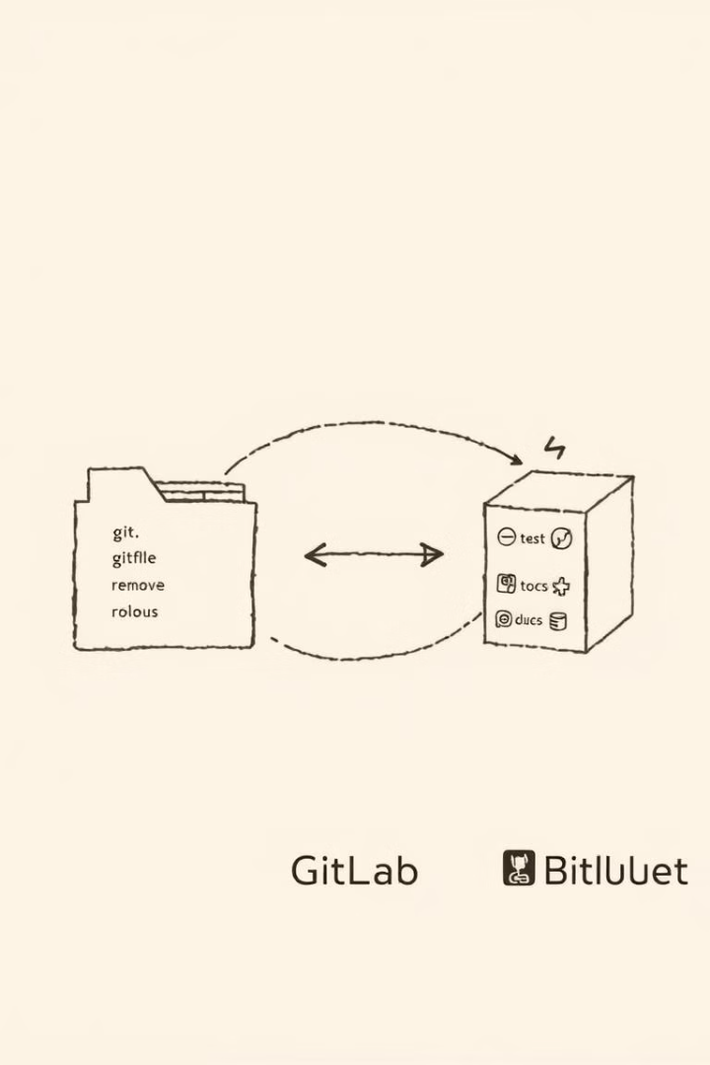
Git Concepts: Repository
Repo
Local/Remote
Storage location for your project.
Can be local or remote.
Contains
Files, history, branches, metadata.

Slide 6
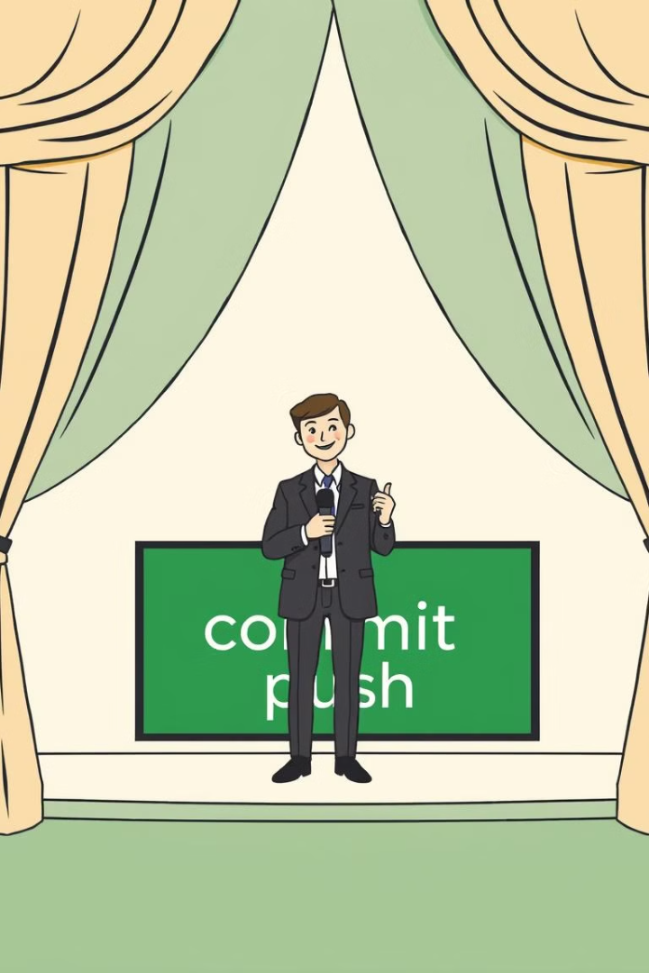


Git Concepts: Staging Area & Commit
Staging Area
Prepare changes before committing.
Commit
Snapshot with a message.

Slide 7
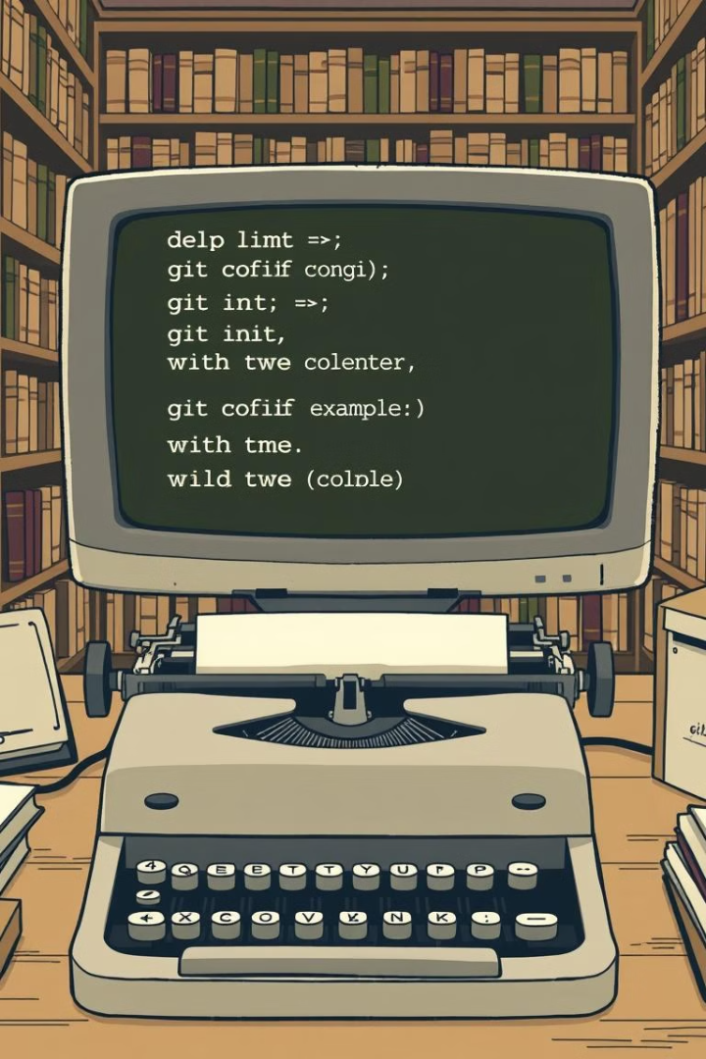
Basic Git Commands: Setup
1
git config
Configure Git settings.
2
git init
Create a new Git repository.
3
git clone
Copy a repo from a remote URL.

Slide 8



Basic Git Commands: Tracking
git add
2
Add changes to staging area.
git status
1
View working directory status.
git commit
3
Commit changes with a message.

Slide 9
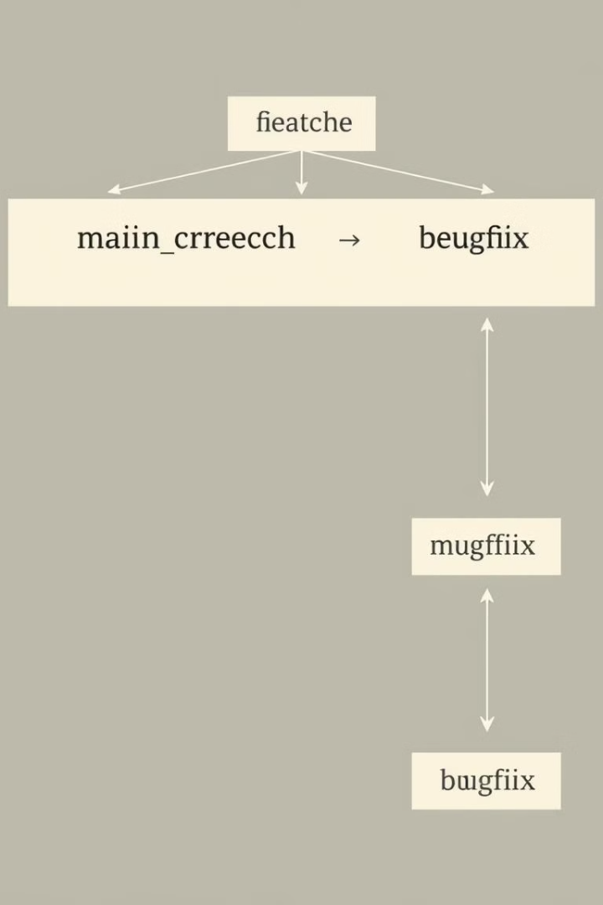
Basic Git Commands: Branching
git branch
List, create, or delete branches.
git checkout
Switch between branches.
git merge
Merge changes from one branch.

Slide 10
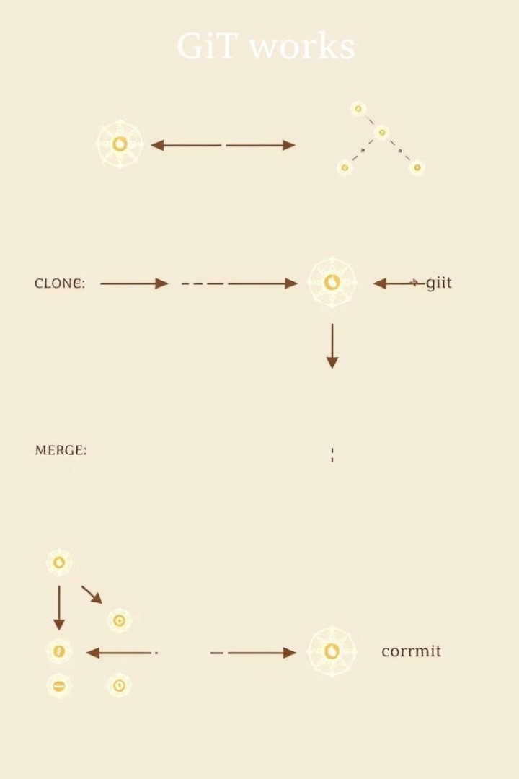


Collaborative Git Workflow
Fetch & Branch
Get latest, work on branch
Pull Request
Create pull request
Code Review
Code review & resolve conflicts
Merge
Merge Pull Request

Slide 11


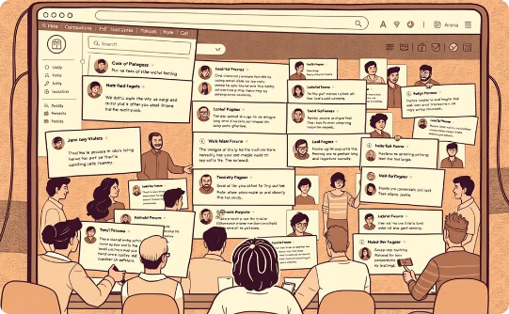
Benefits of Using Git
Enhanced Collaboration
Detailed Version History
Extensive Community Support
Work together seamlessly.
Track every change.
Get help from a wide community.

Slide 12

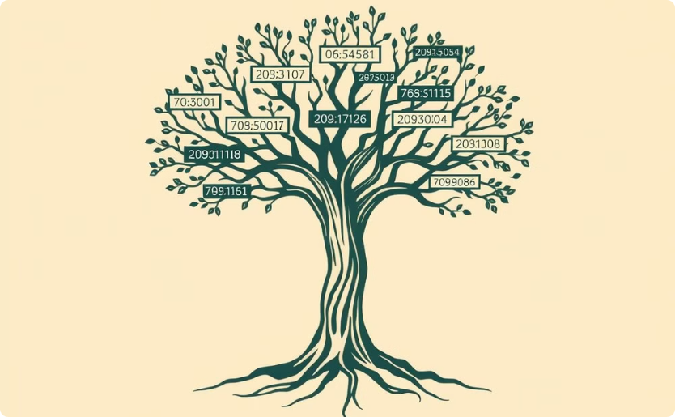
Thank You
Gratitude
Key Takeaway
We appreciate your time and attention.
Git: A powerful version control tool.

